Slide 1
Migraine as a TIA mimic
Mark Weatherall
Consultant Neurologist, Stoke Mandeville Hospital, Buckinghamshire
Chair, British Association for the Study of Headache

Slide 2
Learning objectives
To appreciate how common migraine is as a TIA mimic
To understand the physiological and clinical characteristics of migraine aura
To understand which clinical characteristics of migraine aura are most useful in distinguishing migraine from TIA

Slide 3
How common is this problem?
Swiss study, published 2011 (Cerebrovasc Dis 32:57)
  Prospective study of patients presenting to ED with ?TIA
  55/303 (18.2%) had TIA mimics
  13/55 (23/6%) had migraine (26 had seizure)
Alberta Comprehensive Stroke Center 16 month review
  405/950 patients (42.6%) NOT stroke
  223 (55.1%) neurological mimics, of which 18.8% had migraine
SITS Stroke Thrombolysis Register 2003-17 (Eur J Neurol 26:1091)
  429/10436 thrombolysed patients (4.1%) had mimics, of which 17.5% had migraine

Slide 4
How common is this problem?
a systematic review of papers from 1996-2015, published in Cephalalgia in 2018 (38:2068) concluded that migraine with aura is responsible for 1.79% (CI 95% 0.82-3.79%) of all emergency Stroke Unit evaluations.
  it represents 12.24% (CI 95% 6.34-22.31%) of stroke mimics in the group not treated with systemic thrombolysis.
  6.65% (CI 95% 4.32-9.78%) of systemic thrombolysis administrations are performed in patients without an acute ischemic stroke.
  migraine with aura is responsible for 17.91% of these (CI 95% 13.29-23.71%).
  the reported rate of adverse events seems extremely low (0.01%).

Slide 5
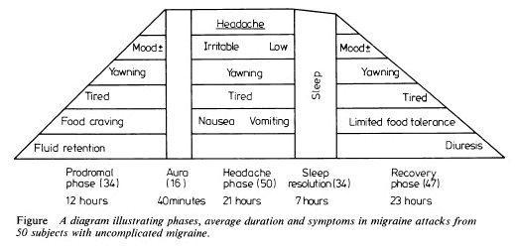
Migraine: more than ‘just a headache’

Slide 6
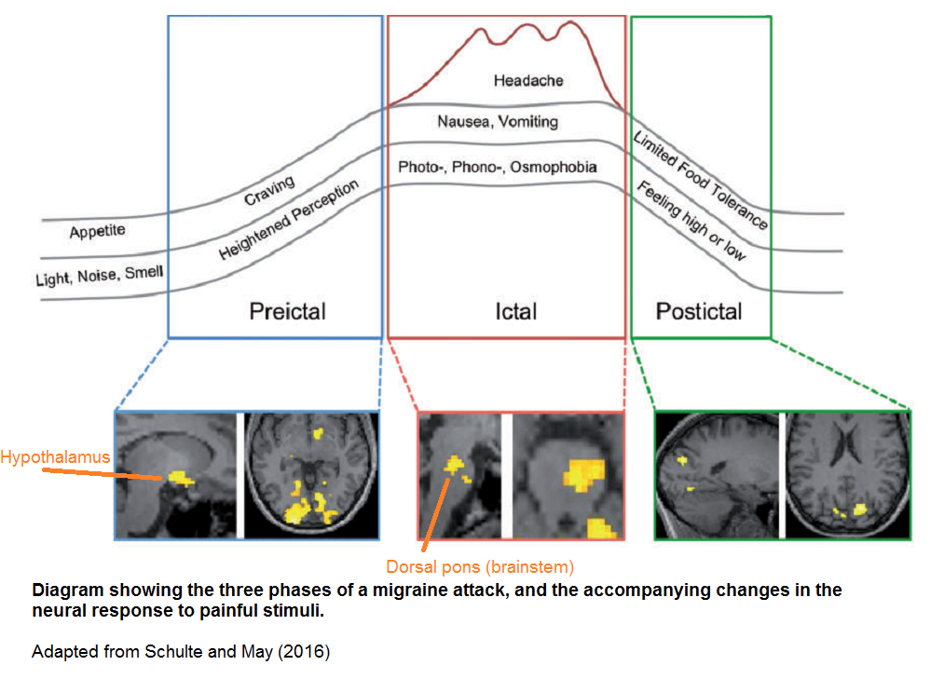
Blau 2.0 (Schulte & May, 2016)

Slide 7
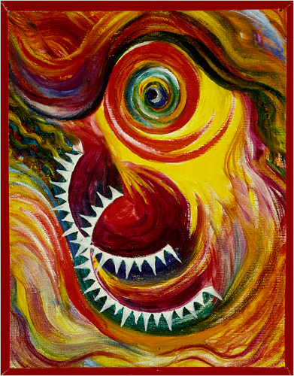
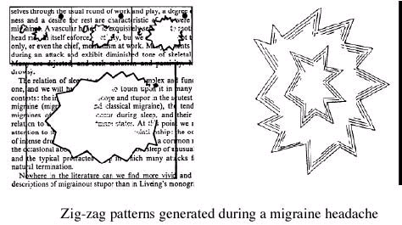
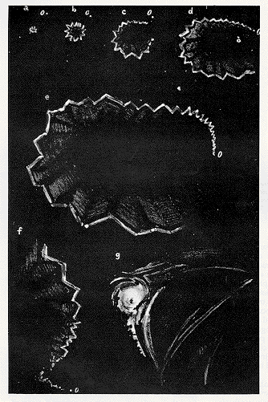
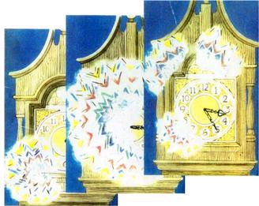
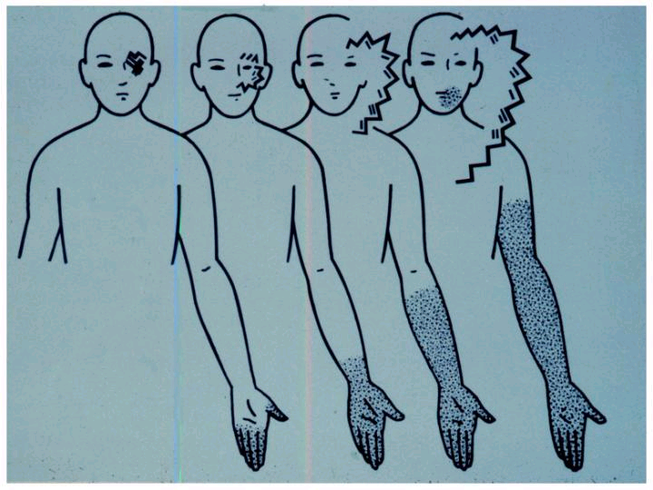
Aura

Slide 8
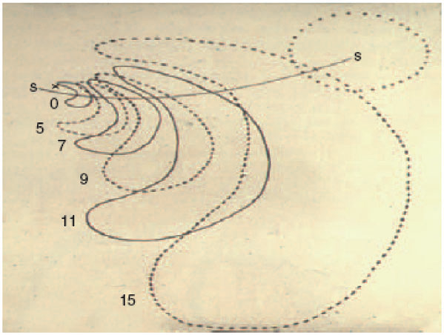
Aura
the American psychologist Karl Lashley studied his own visual aura meticulously – an example of classic ‘psychophysics’
in 1941 he postulated that a wave of inhibition, sometimes preceded by intense excitation, must propagate from his occipital pole at 3 mm/min
in 1959 the Canadian neurologist P M Milner hypothesised that aura might be due to cortical spreading depression, a physiological process first described by the Argentinian physiologist Aristedes Leão in 1944

Slide 9
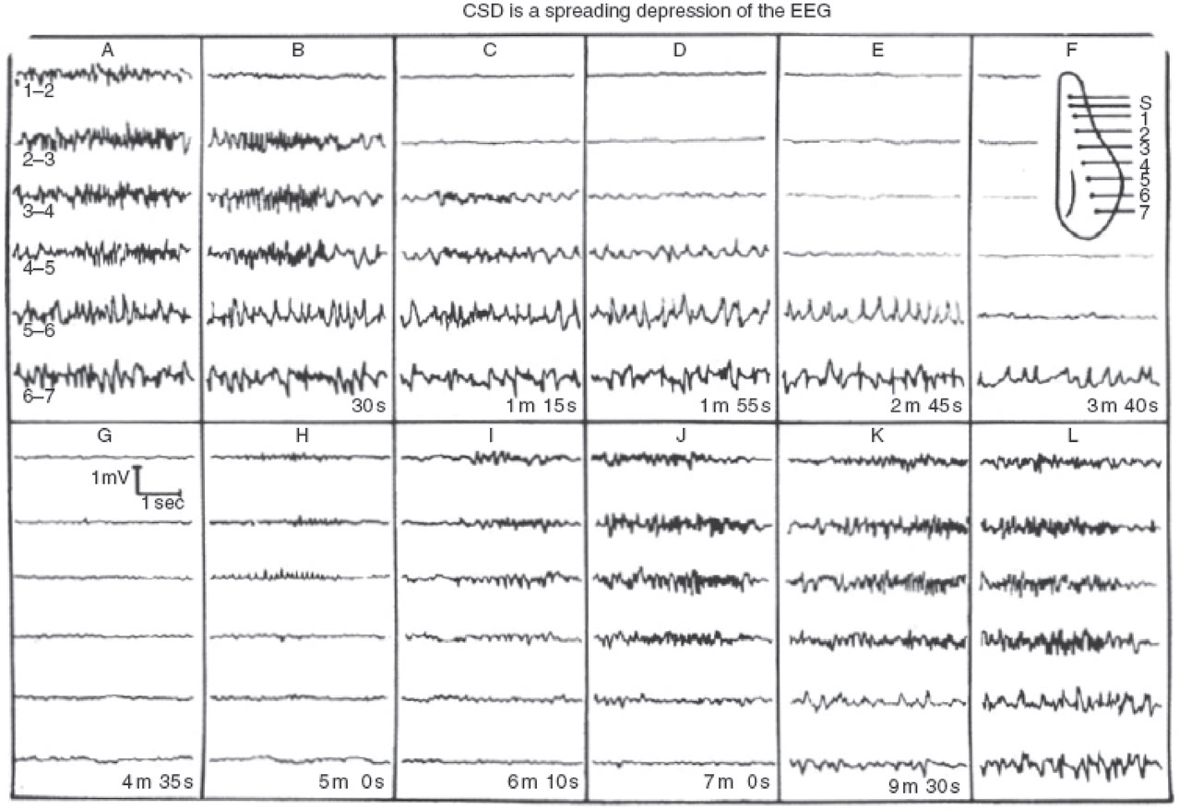
Cortical spreading depression
cortical spreading depression is an intense depolarising wave of neuronal and glial membranes that spreads slowly across the cortex
  accompanied by brief hyperperfusion that lasts 1-2 minutes, then depolarization and hypoperfusion that can last 1-2 hours (~20-30% reduction in CBF)
CSD can be triggered experimentally by electrical or mechanical stimulation, hypoxia, ischaemia, embolism (air bubbles, cholesterol, crystals, endothelin)

Slide 10
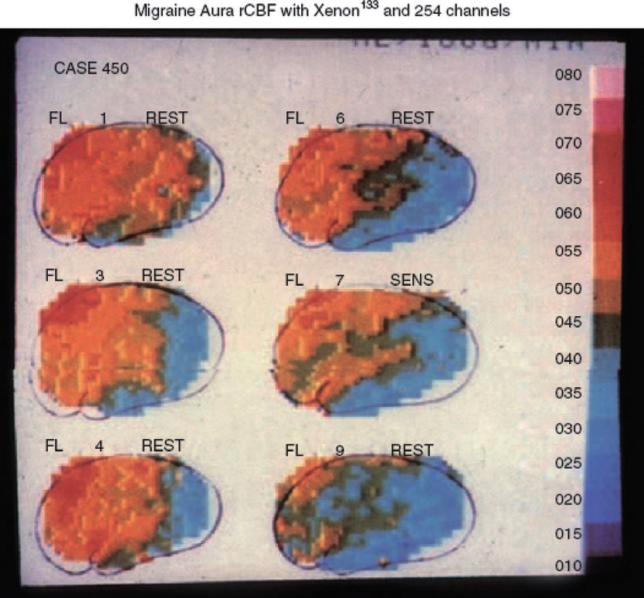
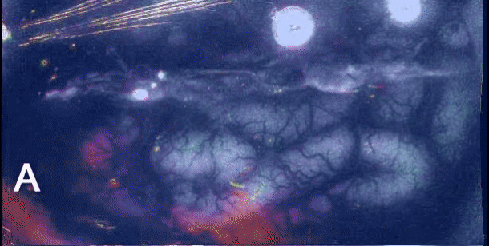
Cortical spreading depression
Cortical spreading depression seen using intrinsic optical signal imaging in gyrencephalic brain. Speed 50x. From Santos E et al. Neuroimage 2014.

Slide 11
How do we diagnose migraine with aura?

Slide 12
ICHD-3 diagnostic criteria for MO & MA

Slide 13
ICHD-3 criteria for migraine with brainstem aura (‘basilar’) & hemiplegic migraine

Slide 14
How can we distinguish migraine from TIA?

Slide 15
Can we use ICHD-3 for TIA vs migraine?
120 patients presenting to Russian hospital with TIA, evaluated within 24 hours of event
  TIA defined as new symptomatic neurological deterioration lasting <24 hrs with no new infarction on neuroimaging
patients submitted to testing of proposed versions of ICHD-3β criteria for MA to test specificity of criteria
  sensitivity tested in 1157 patients from previous publication diagnosed with MA according to previous version of ICHD
all versions provided high specificity & sensitivity if the criterion a previous identical attack was met – what about for a first ever attack?

Slide 16
Can we use ICHD-3 for TIA vs migraine?

Slide 17
Can we use ICHD-3 for TIA vs migraine?

Slide 18
Conclusion
Migraine is a common TIA/stroke mimic
Migraine aura typically consists of a combination of positive and negative symptoms
The presence of positive symptoms and evolution of symptoms over time strongly suggest migraine rather than TIA

